Slide 1



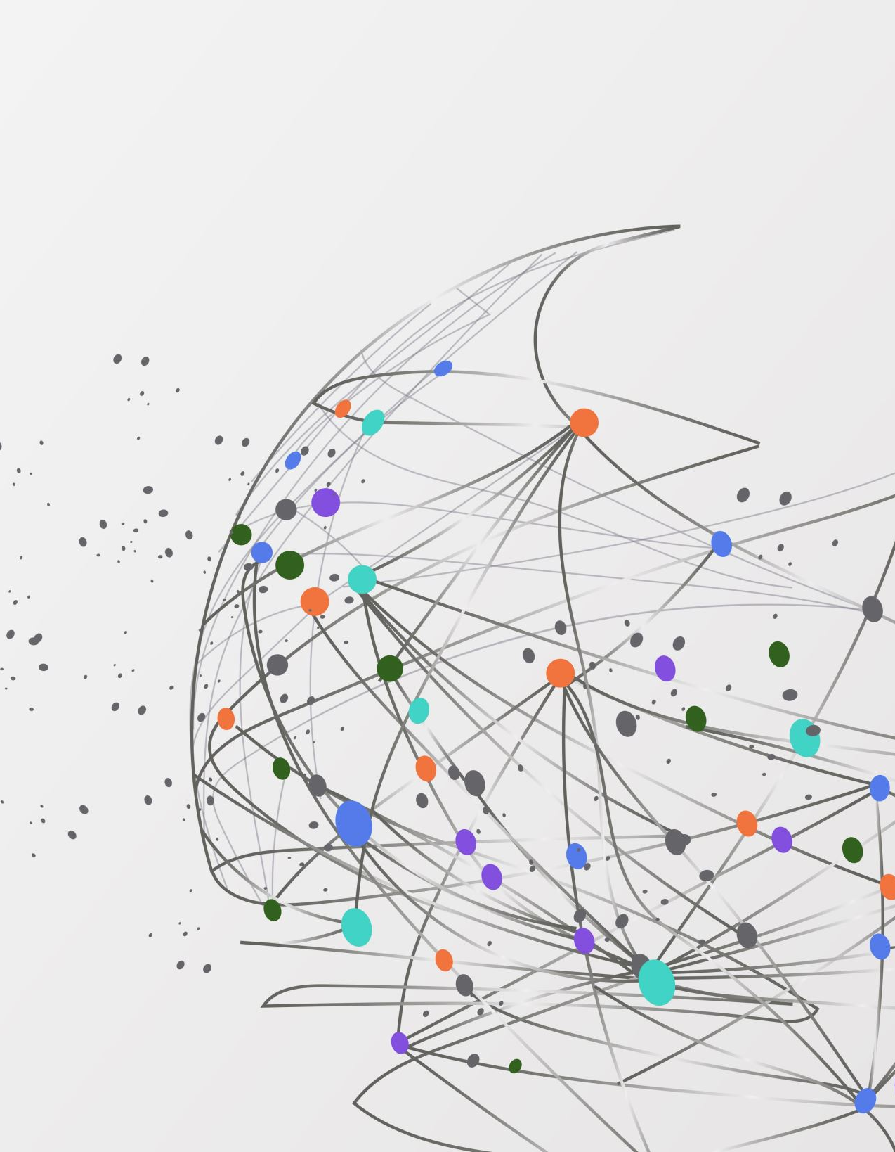
INTRODUCTION TO ARTIFICAL INTELLIGENCE
TERM PROJECT – PROPOSAL
X’s and O’s
BY:
TRINADH NANDAMURI
VARSHITHA JONNALAGADDA
RISHITH RAO CHEETI

Slide 2

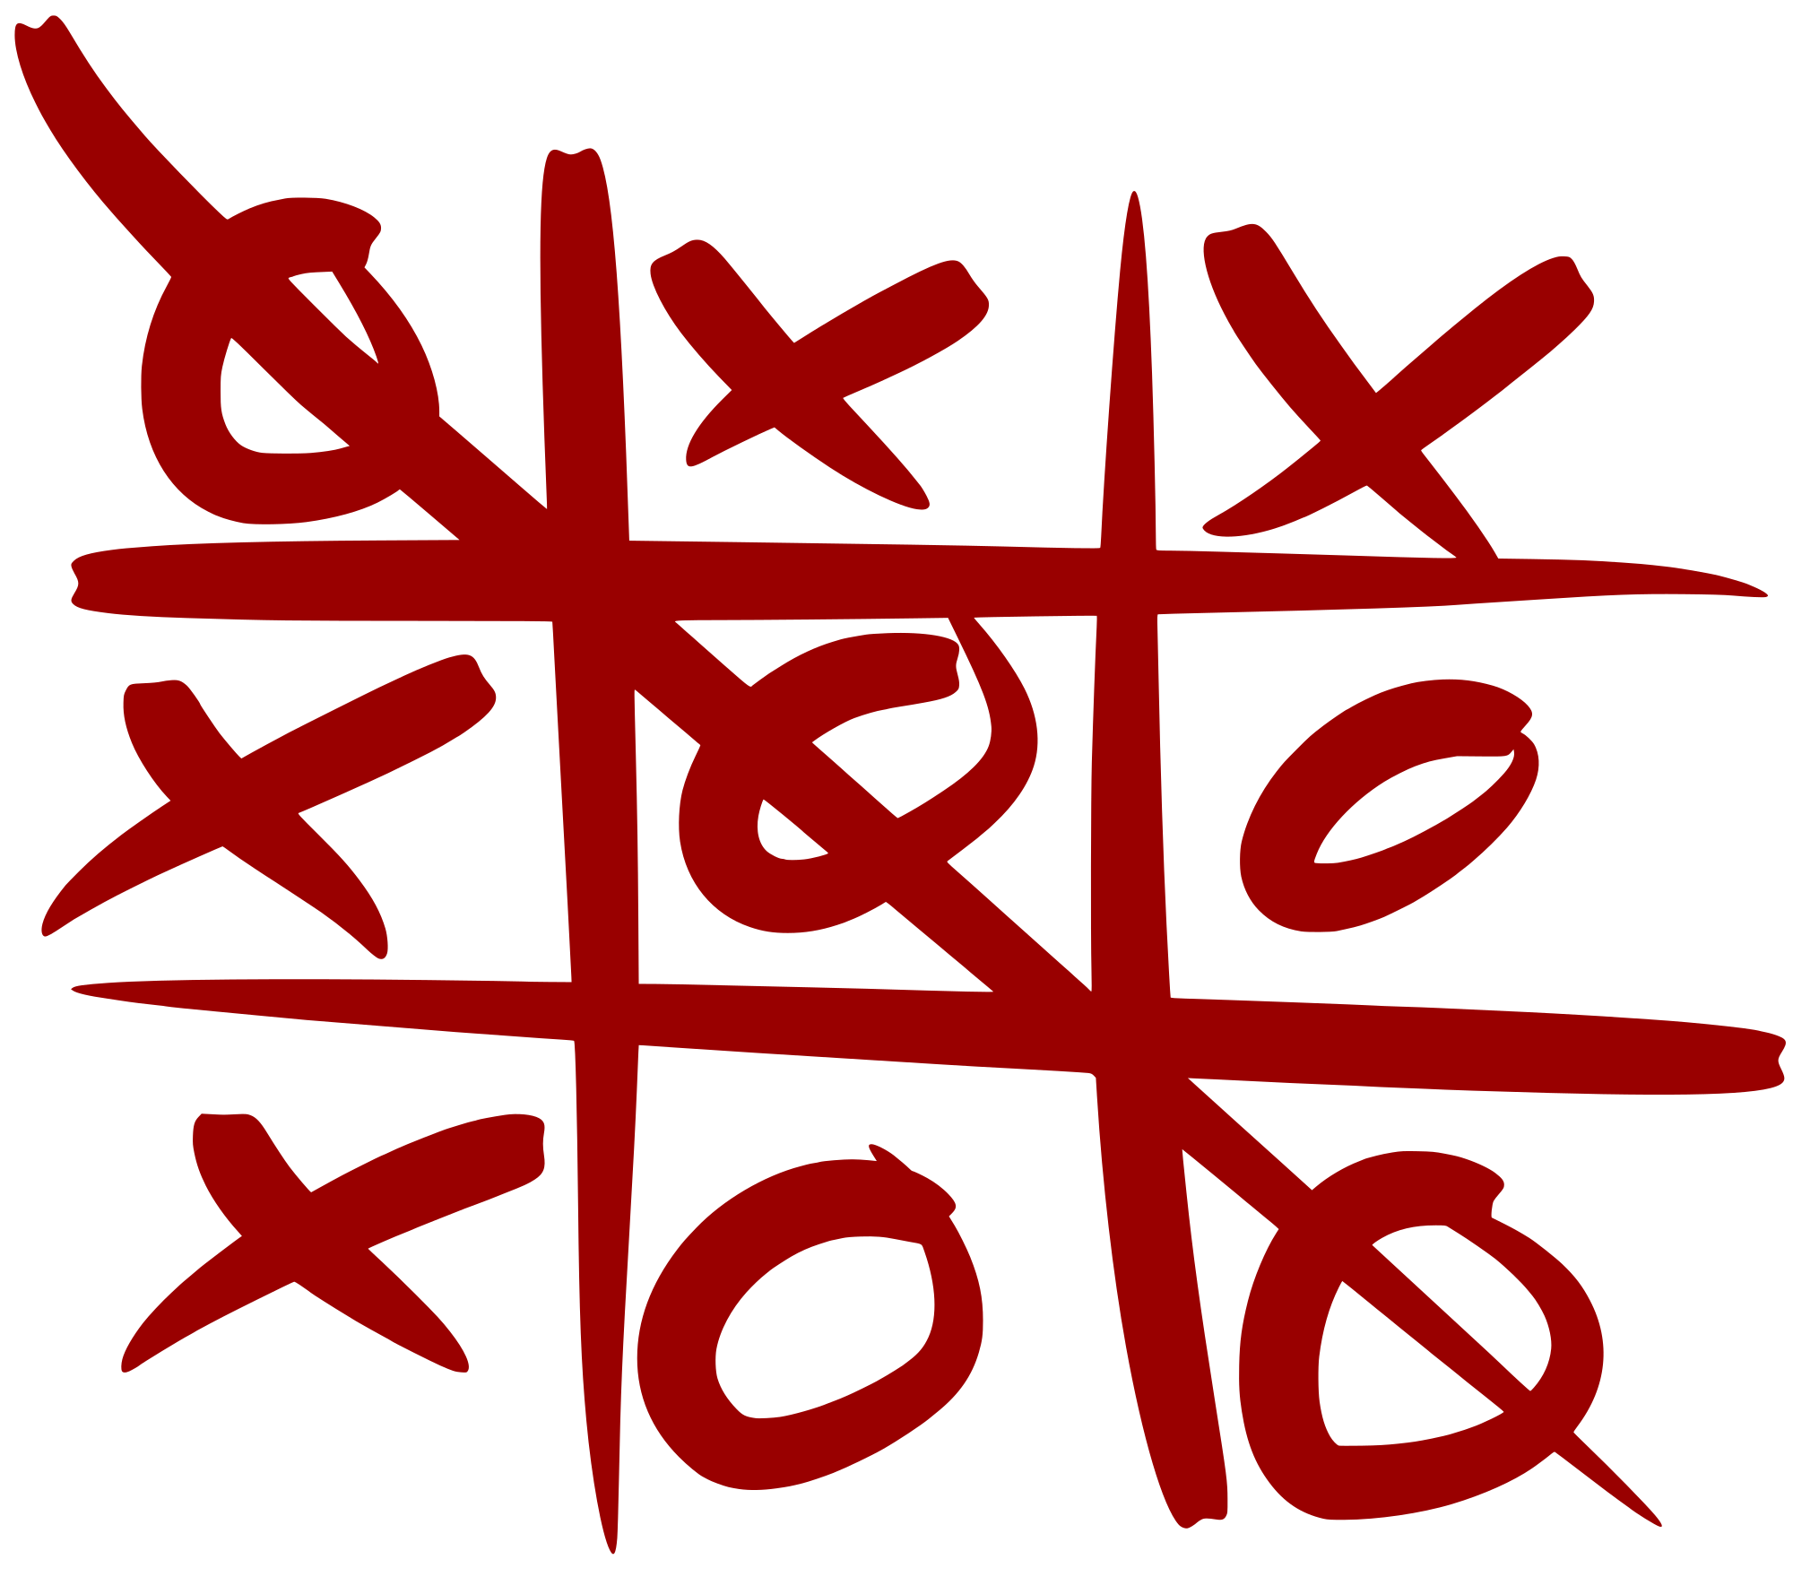
X’s and O’s
A game having two players alternately opting X’s and O’s between two horizontal and vertical lines trying to get quickest pattern of three consecutive X’s or O’s

Slide 3
OBJECTIVES
Training Agents
Implementation of X’s and O’s using multiple agents.
Organizing a tournament within these agents.
Agent forming the quickest sequence and remaining undefeated till the end is declared as our winner
Conducing Tournament
Winner

Slide 4
APPROACH
Designing a layout which is a 3x3 grid.
Agent training about the game play atmosphere using Minimax, Expectimax and QLearning algorithms.
Define the agent which minimizes our utility and develop a counter strategy for our self to maximize our utility
The limitations of minimax can be overcome by using expectimax which further expands our utility.
Further, we add a choice node to study actions of the agent and use Q learning algorithm to get the maximum utility.

Slide 5
DELIVERABLES
Algorithms developed to train agents using programming. (.py files)
Documentation manual mentioning about game implementation about various models.
Presentation on project overview.
YouTube link demonstrating the game implementation.
GitHub link for the project

Slide 6

EVALUATION METHODOLOGY
Accuracy: To check results for random inputs and whether constraints are satisfied.
Correctness: To check whether the output results are correct.
Winner: The agent giving us the best result and winning the tournament.

Slide 7
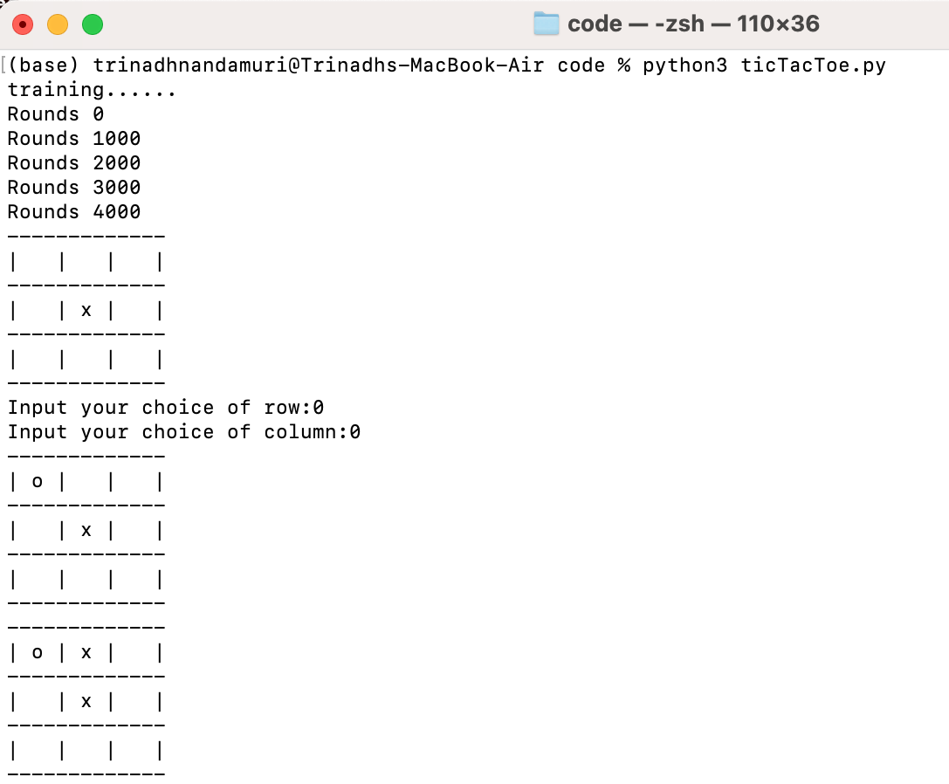
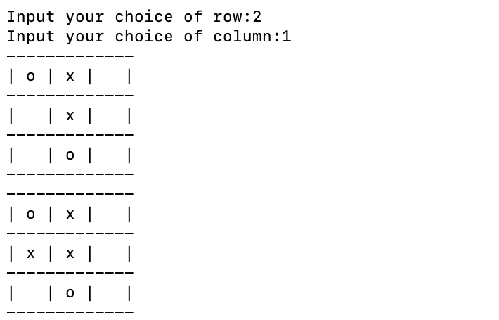
RESULTS
When it is a Tie

Slide 8
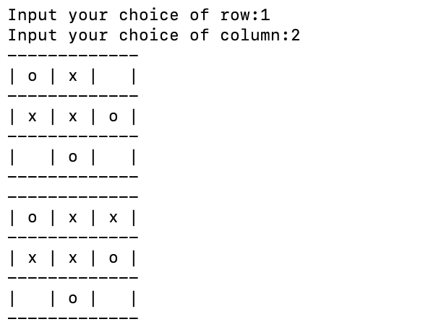
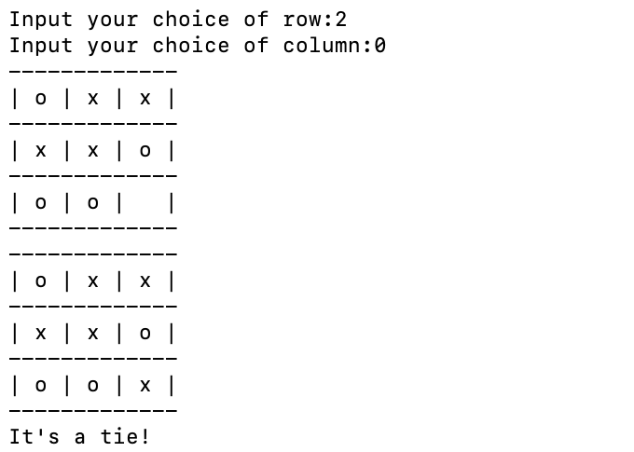
RESULTS
When it is a Tie

Slide 9
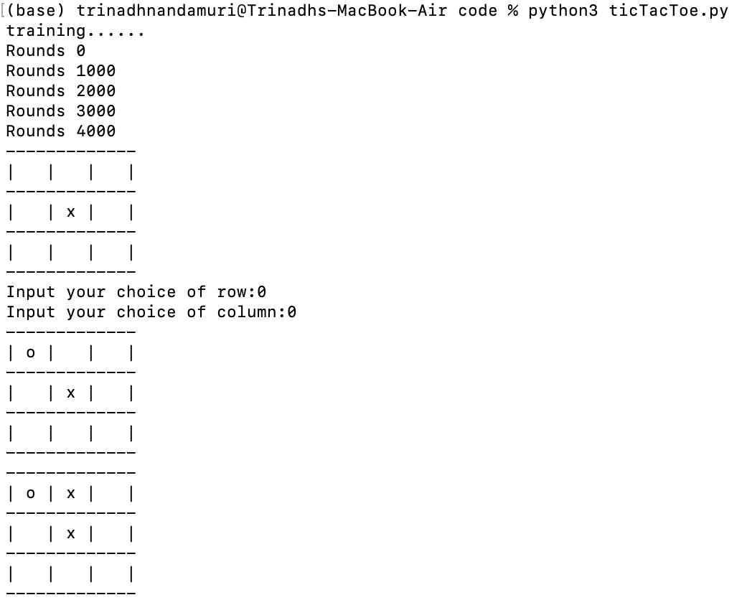
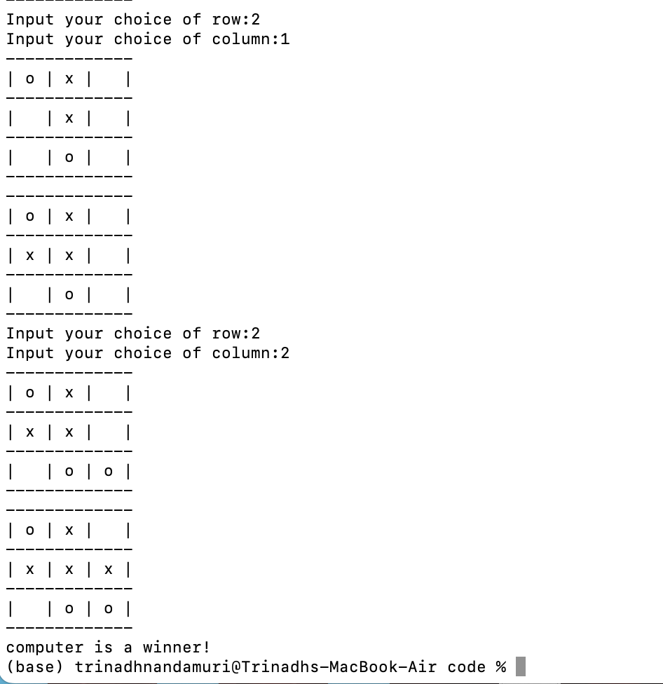
RESULTS
When Computer Wins

Slide 10

THANK YOU 🙂

